Slide 1

OBESITY LEVEL ANALYSIS
By - Kathula Shalom Ramesh

Slide 2
TABLE OF CONTENT
Introduction To The Project
Object Of The Project
Obesity Analysis
Suggested And Recommended
Conclusion

Slide 3
Introduction
Obesity is a global health concern, affecting millions of people across all demographics. It is a complex condition influenced by a variety of factors including genetics, environment, lifestyle choices, and socioeconomic status.
The rising prevalence of obesity has significant implications for public health, as it is associated with numerous chronic diseases such as diabetes, cardiovascular disease, and certain cancers.
The primary objective of this analysis is to explore and understand the various factors contributing to obesity levels among individuals.

Slide 4
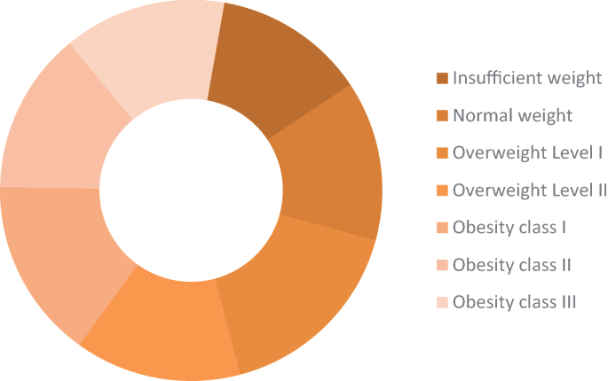
Object of the project :
The primary objective of this project is to analyze and understand the factors contributing to obesity levels among individuals using comprehensive data visualization techniques. By leveraging Tableau, we aim to identify patterns and correlations between various lifestyle factors and obesity levels, ultimately providing actionable insights for health and wellness initiatives.
Specific Goals :
Analyze Distribution of Obesity Levels
Dietary Habits and Obesity
Physical Activity and Obesity
Lifestyle Factors

Slide 5
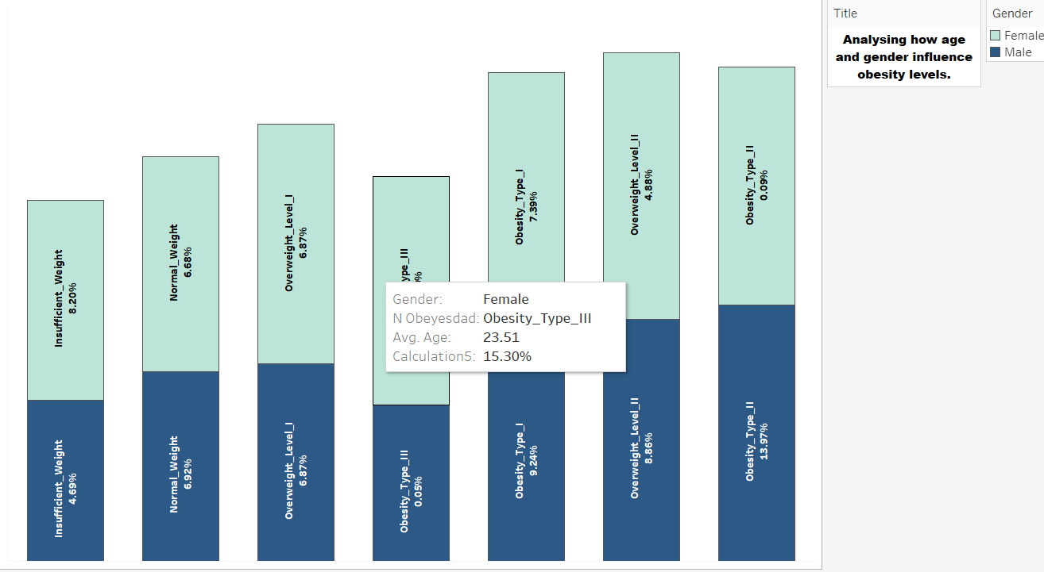
OBESITY ANALYSIS:
To analyze and interpret the factors influencing obesity levels. Breakdown of different obesity levels by different chart showing the distribution of obesity levels.
Interpretation Gender-wise Distribution:
Developing gender-specific programs that address unique lifestyle and behavioral factors could be more effective in combating obesity
In Gender wise distribution we will be examining obesity levels across genders
We can visualize the data by bar chart comparing obesity levels between males and females
Underweight and Normal Weight:
Males have a higher percentage in the normal weight category compared to females, suggesting a potential difference in body composition or lifestyle factors.
Overweight and Obesity Categories:
Females show a higher percentage in the higher obesity categories (Obesity Type II and III)
Cultural factors, dietary habits, and physical activity levels might differ between genders, contributing to the variations in obesity levels.
Higher obesity levels in females may increase their risk for conditions like type 2 diabetes and cardiovascular diseases, necessitating gender-specific health initiatives

Slide 6
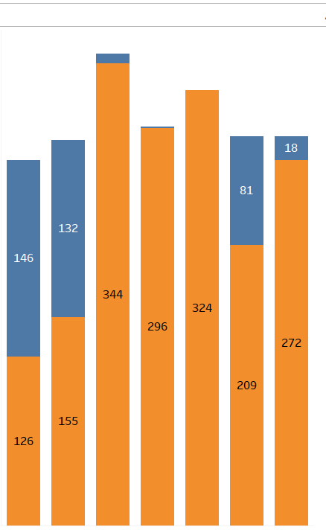
Interpretation for Family History of Overweight
To understand the impact of family history on obesity levels,we will be comparing the distribution of obesity levels Individuals with and without a family history of overweight.
Individuals with a family history of overweight show a higher prevalence of being overweight and obese compared to those without such a history.
After analysing this ,it may be due to genetic factors and familial lifestyle habits,Lifestyle Influence likely contribute to this trend. Children of overweight parents may inherit genes that predispose them to obesity and may also adopt similar eating and activity patterns
A comparison of obesity levels among individuals without a family history shows a lower prevalence of severe obesity.
This highlights the effectiveness of preventive measures and the potential for mitigating genetic risk through healthy lifestyle choices, such as balanced diet, regular physical activity, and proper hydration.

Slide 7
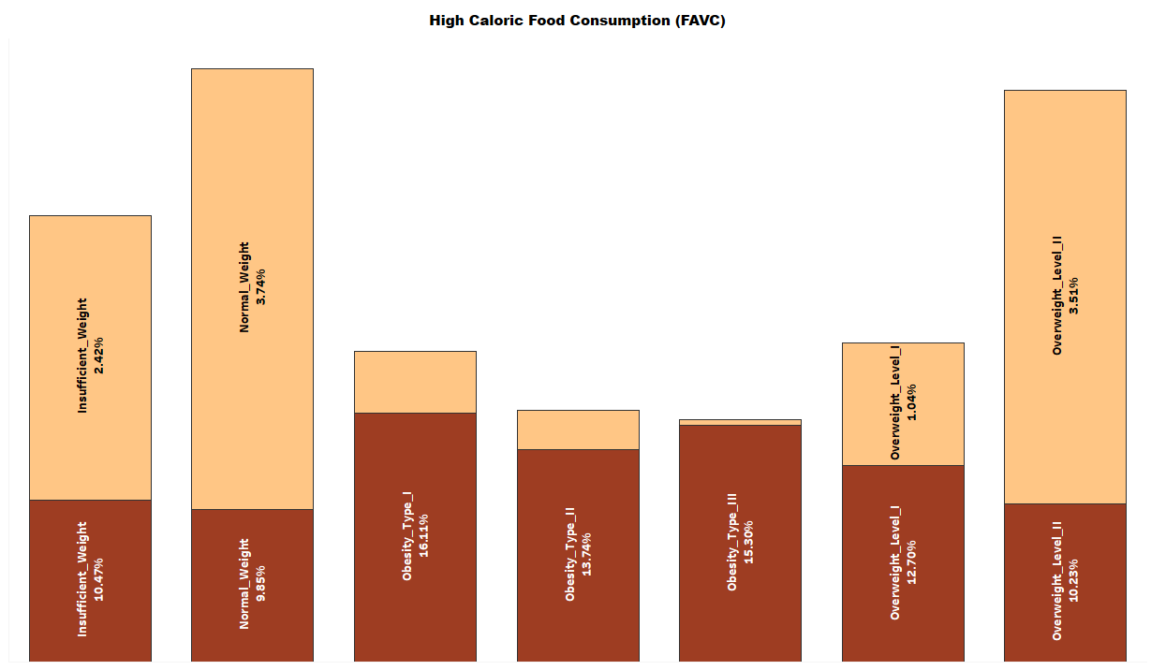
Interpretation for High-Caloric Food Consumption
The analysis focuses on the relationship between high-caloric food consumption and obesity levels. The data reveals how often individuals who consume high-caloric foods (e.g., fast food, sugary snacks) fall into different obesity categories.
The consumption of high-caloric foods is strongly associated with higher obesity levels. This suggests that dietary habits play a crucial role in an individual's weight status
Frequent consumption of high-caloric foods leads to higher calorie intake, which, if not balanced with physical activity, results in weight gain and obesity.
Public health initiatives should focus on promoting healthier eating habits. This can include education campaigns about the risks of high-caloric food consumption and the benefits of a balanced diet rich in fruits, vegetables, and whole grains.
Policies could be implemented to reduce the availability of high-caloric foods, such as limiting fast-food outlets, imposing taxes on sugary drinks, and providing incentives for healthier food options.

Slide 8
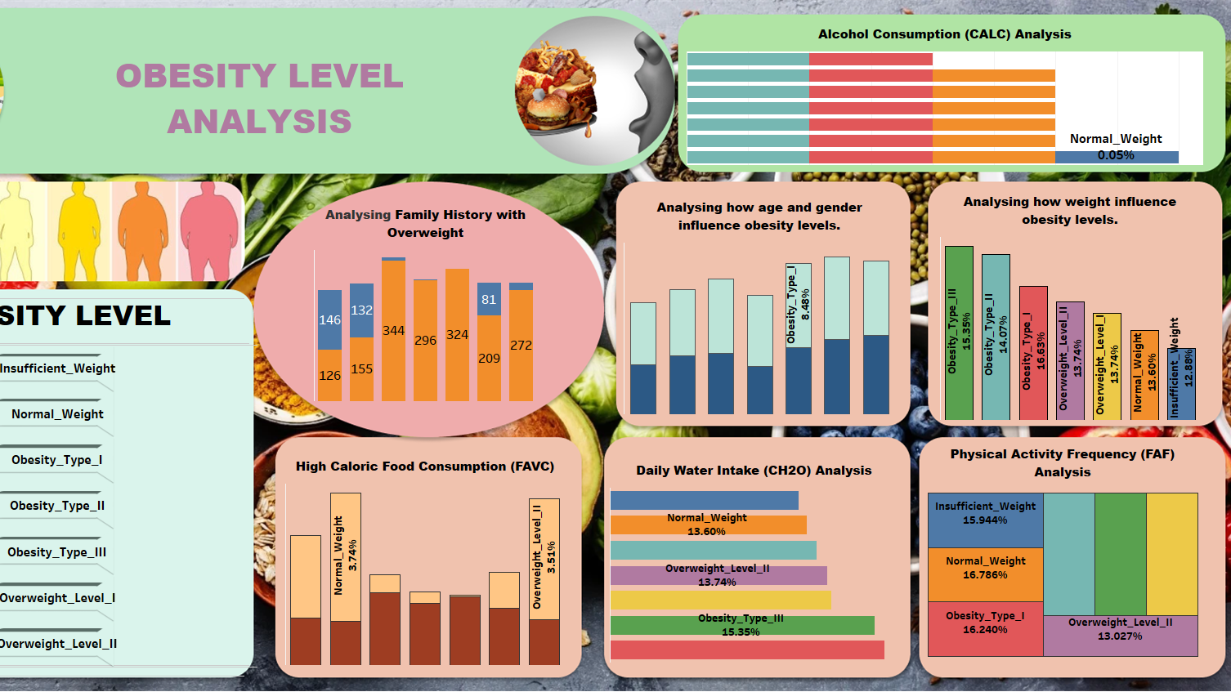
Interactive Dashboard :

Slide 9

Suggested And Recommended :
Public Health Interventions: Addressing obesity requires multifaceted approaches, including promoting healthier diets, encouraging physical activity, and raising awareness about lifestyle impacts.
Policy Considerations: Policymakers should consider initiatives focused on [specific policy recommendations based on findings], aimed at reducing obesity prevalence.
Future Research: Future studies should explore [potential areas for further investigation], such as [specific topics identified for deeper exploration].

Slide 10
Conclusion :
This analysis provides valuable insights into the multifaceted nature of obesity, highlighting the interplay of genetics, lifestyle choices, and environmental factors.
The findings from this obesity level analysis underscore the complex interaction of genetic, environmental, and lifestyle factors in shaping obesity prevalence. By understanding these dynamics, stakeholders can develop targeted interventions to combat obesity effectively and improve public health outcomes.
This study not only enhances our understanding of obesity but also provides actionable insights that can inform policy, practice, and future research initiatives aimed at tackling this global health challenge.

Slide 11


